Slide 1

Introduction to Wynk Music Replica
Explore the world of Wynk Music Replica, a captivating digital platform that replicates the experience of discovering and enjoying music. Immerse yourself in a seamless, personalized journey as you discover new artists, create playlists, and unlock the power of music in your life.
by

Slide 2
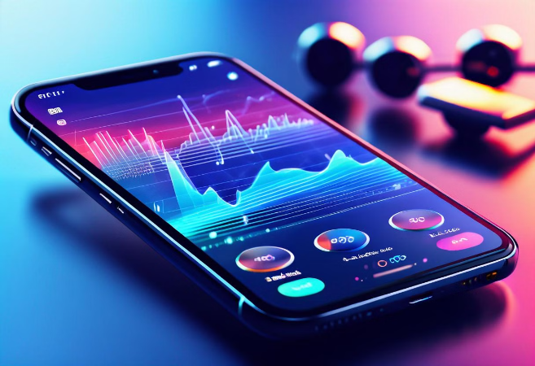
Overview of Wynk Music
Wynk Music is a popular music streaming service that offers a vast library of songs, playlists, and podcasts. It provides users with an immersive listening experience, allowing them to discover new artists, create personalized mixes, and enjoy high-quality audio on the go.

Slide 3
Key Features of Wynk Music Replica
1
Extensive Music Library
2
High-Quality Streaming
Wynk Music Replica offers access to millions of songs across various genres, providing users with an expansive catalog to explore and discover new music.
The app delivers music in high-definition audio quality, ensuring an immersive and enjoyable listening experience for users.
3
Personalized Recommendations
4
Offline Playback
The app's intelligent algorithms analyze user preferences and listening history to provide customized song recommendations, helping users find new music they'll love.
Users can download songs and playlists for offline listening, allowing them to enjoy their music without an internet connection.

Slide 4
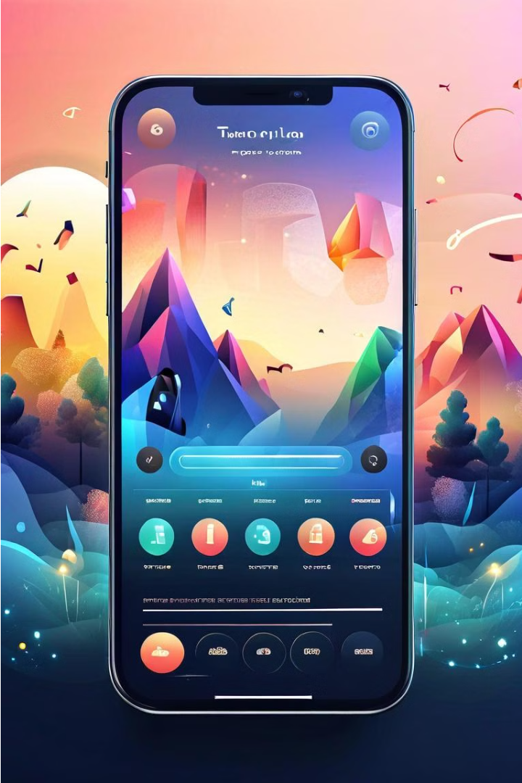
User Interface and Navigation
The Wynk Music Replica features a sleek and intuitive user interface designed for seamless music discovery and playback. The app's navigation menu provides easy access to key features like the library, playlists, and personalized recommendations.
The central music player allows users to effortlessly control playback, adjust volume, and view album art and song details. Intuitive gestures and controls make for a smooth and responsive experience.

Slide 5



Music Library and Catalog
Diverse Genres
Intuitive Search
Album Browsing
Wynk Music Replica offers an extensive music library spanning a wide range of genres, from the latest hits to timeless classics.
Easily navigate the extensive catalog using Wynk's powerful search functionality to find your favorite songs, artists, and albums.
Visually browse through the vibrant album covers to discover new music and explore your favorite artists' discographies.

Slide 6

Streaming Quality and Performance
Wynk Music Replica offers high-quality streaming for an exceptional audio experience. The platform utilizes advanced audio codecs and adaptive bitrate streaming to ensure the best possible sound quality, adjusting seamlessly to the user's internet connection and device capabilities.
With up to 320 kbps bitrate for premium users, the music playback is crisp, clear, and immersive, delivering a true-to-life listening experience. The robust and optimized streaming engine minimizes buffering and lag, providing a smooth and uninterrupted playback, even on slower network connections.

Slide 7
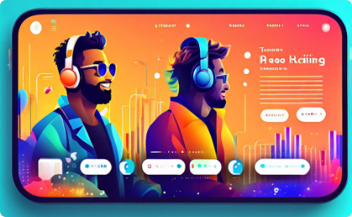
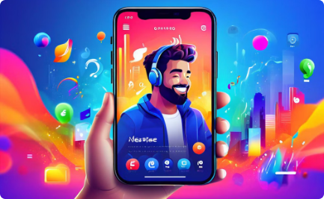
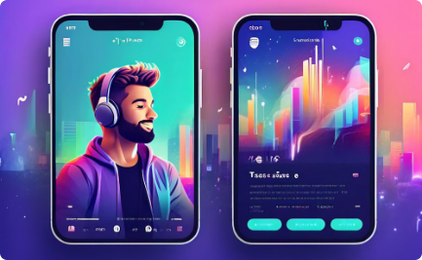
Personalized Recommendations
Tailored Suggestions
Social Recommendations
Curated Playlists
Wynk Music Replica's advanced algorithms analyze your listening habits to provide personalized song, artist, and playlist recommendations that cater to your unique musical tastes.
You can also discover new music through the recommendations of your friends and the Wynk community, fostering a social listening experience.
In addition to personalized recommendations, Wynk Music Replica offers expertly curated playlists across a wide range of genres and moods to suit your every listening need.

Slide 8
Offline Listening and Downloads
Seamless Offline Access
High-Quality Downloads
Smart Storage Management
Wynk Music Replica allows users to download their favorite songs and playlists for offline playback, ensuring uninterrupted listening experiences even without an internet connection.
Downloaded tracks are available in high-bitrate audio formats, delivering exceptional sound quality for an immersive offline listening experience.
The app intelligently manages downloaded content, allowing users to easily free up storage space by deleting tracks they no longer need.

Slide 9

Social Sharing and Collaboration
Wynk Music Replica empowers users to seamlessly share their favorite tracks, playlists, and albums with friends and family. With built-in social features, users can follow each other's music activities, leave comments, and even collaborate on curated playlists.
The app also integrates with popular social media platforms, allowing users to share their musical discoveries and recommendations across their existing networks.

Slide 10

Conclusion and Next Steps
In summary, the Wynk Music Replica app delivers a comprehensive and seamless music listening experience. With a vast catalog, personalized recommendations, and advanced features, it empowers users to discover, stream, and enjoy music like never before.

